Slide 1
Big Data Analytics for Healthcare NURS 741
Vicki Stover Hertzberg, PhD
Melinda Higgins, PhD

Slide 2
Session 1
Motivate
Details – what we will do in this class
Some work in R

Slide 3
Learning Objectives - I
Demonstrate knowledge of the principles undergirding the tools of big data analysis in health related research.
Identify the potential of, and challenges to, incorporating big data analytics to improve the development and testing of precision medicine / nursing interventions.

Slide 4
Learning Objectives - II
Understand the principles of reproducible research and implement an appropriate workflow for data analysis and manuscript / report generation.
Effectively critique published research of health related studies conducted by using big data theoretical frameworks and research techniques.

Slide 5
Learning Objectives - III
Analyze ethical issues related to the use of big data analytics in health related research
Demonstrate knowledge of how data are gathered, stored, managed, and analyzed for big data analytics.

Slide 6
Terms We Will Use Interchangeably
Big Data
Analytics
Data Science

Slide 7
Is Big Data a thing like Big Hair?
D. Brogan
Notes:
Donna hired vicki more than 20+ years ago

Slide 8
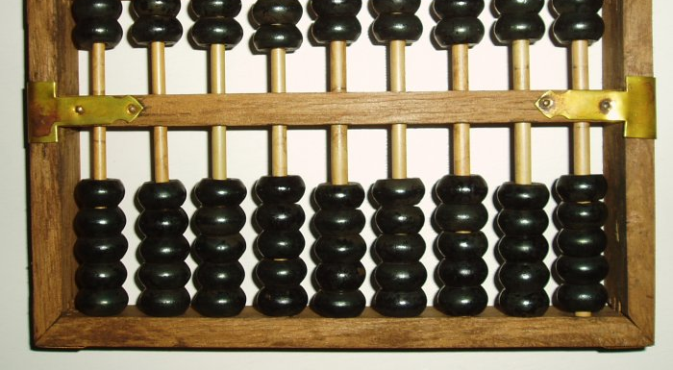
Historical Frame of Reference

Slide 9
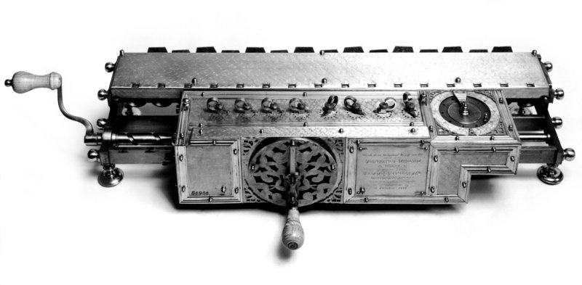
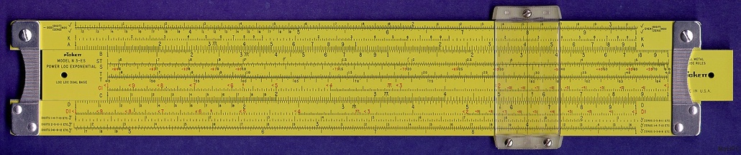
Historical Frame of Reference

Slide 10
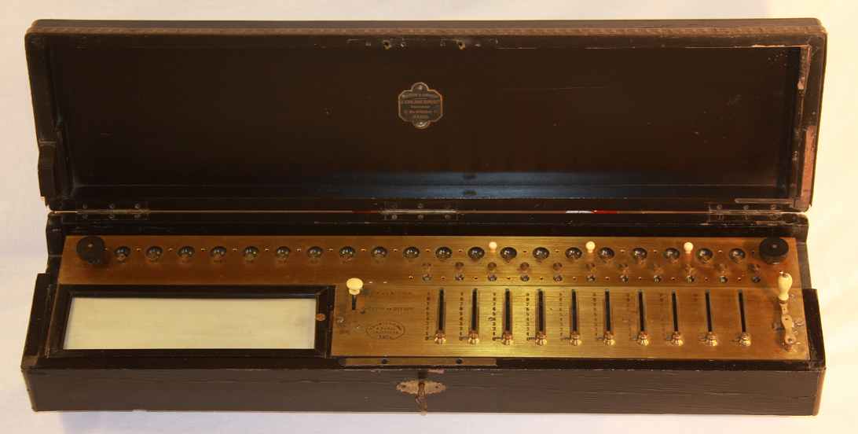
Historical Frame of Reference
Historical computational tools
(clockwise from top left):
Abacus (~2500 BC)
Leibniz Stepped Reckoner (~17th C.)
Thomas Arithmometer (~19th C.)
Slide Rule (~17th C.)

Slide 11
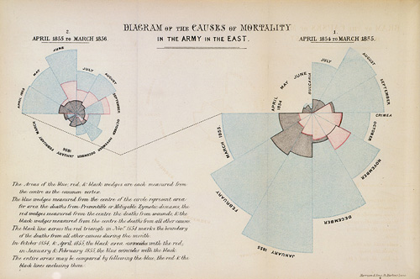
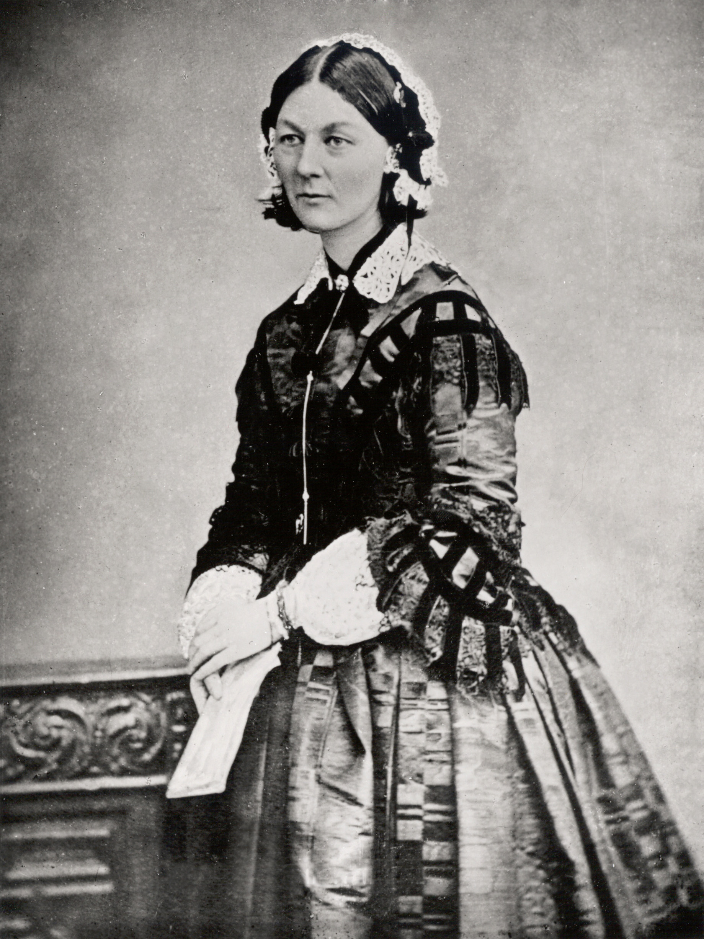
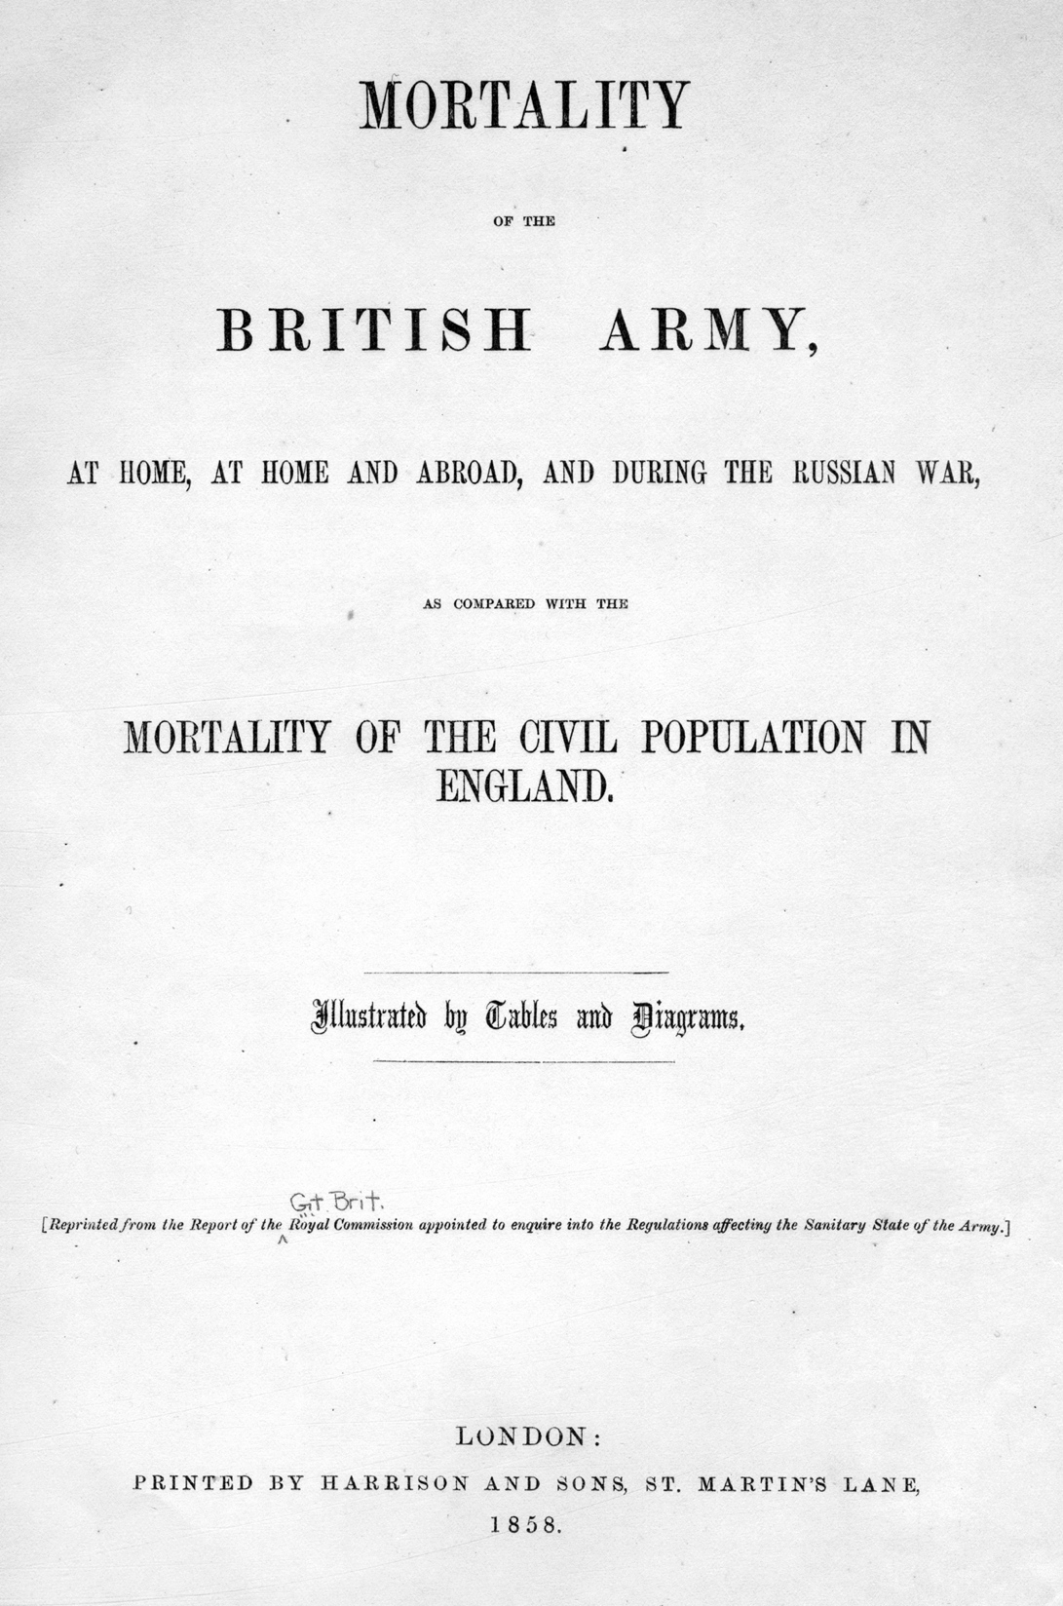
Historical Applications to Nursing
Florence Nightingale:
A most famous statistician

Slide 12
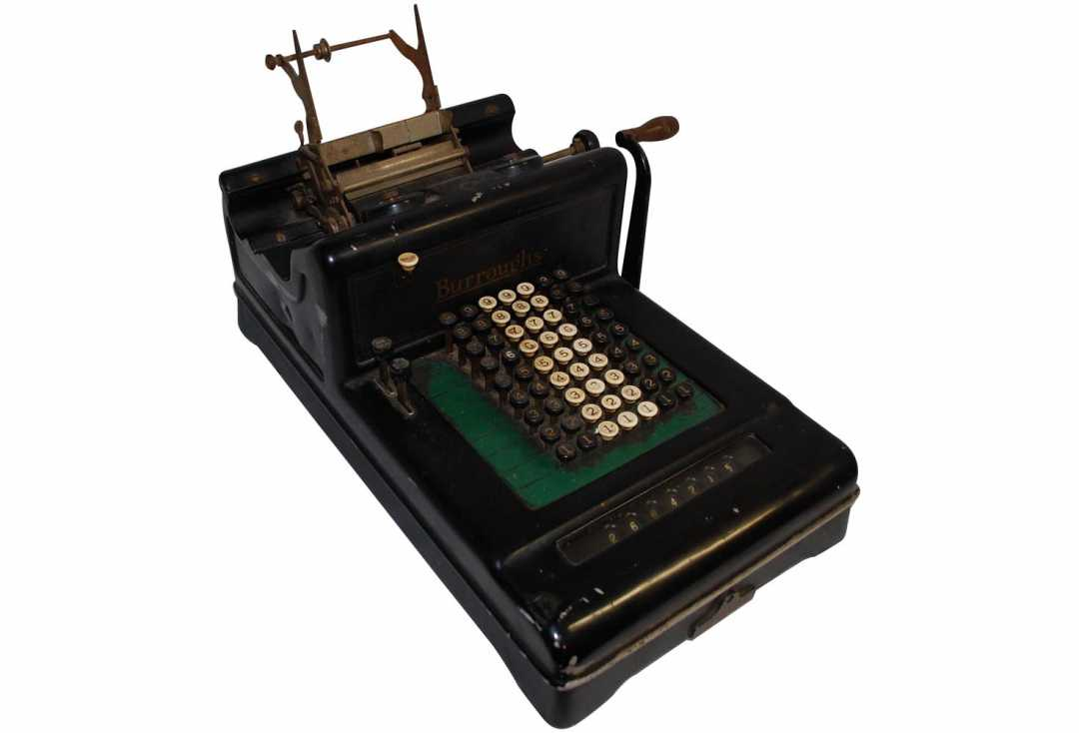
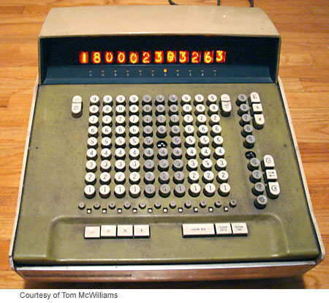
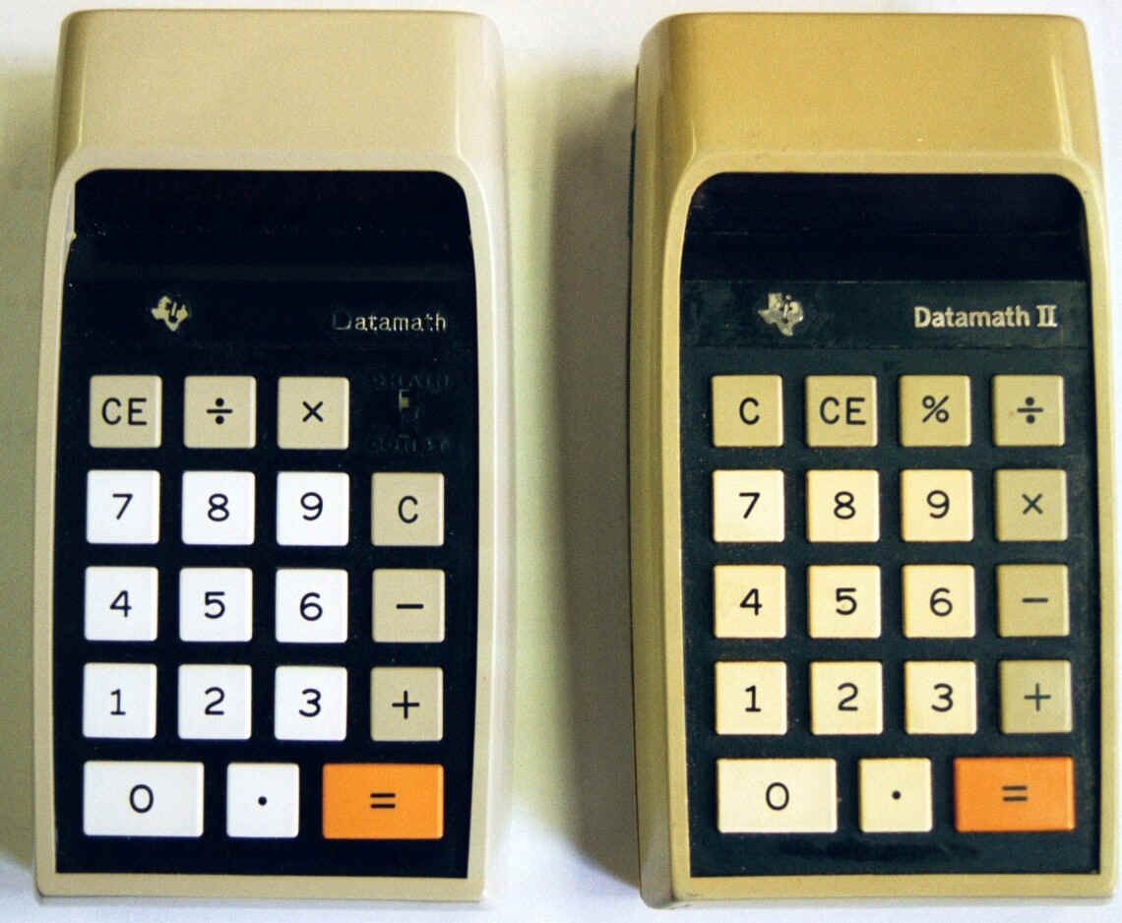
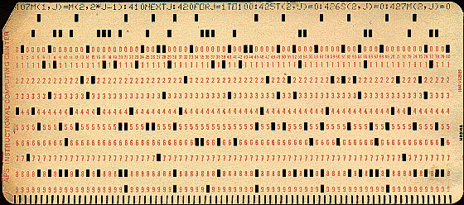
Historical Frame of Reference

Slide 13
Difference Today
Used to have to exert considerable effort to obtain the data
Now data are ubiquitous
Administrative records
Clinical records
Digital traces
Etc.

Slide 14
Definition of Big Data
“Ever expanding trove of digital data”
Elements
Electronic health record (EHR)
Patient generated health data (PGHD)
Imaging
Sequencing
Etc.

Slide 15
Definition of Analytics
“Extensive use of data, statistical and quantitative analysis, explanatory and predictive models, and fact-based management to drive decisions.”
“An understanding of the relationships within and among various pieces of data.”
“Extract new insights or create new forms of values from existing data in ways that change markets, organizations, and the relationships between citizens and governments.”

Slide 16
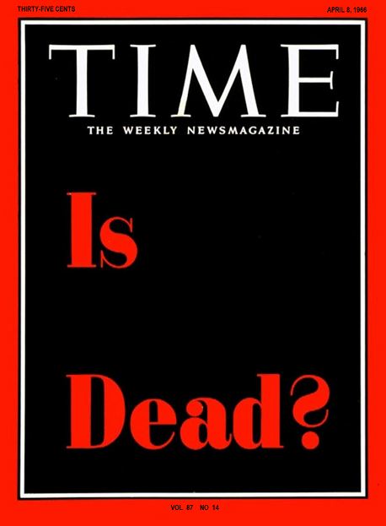



Slide 17

Is Theory Dead?
Notes:
Question today – more is theory dead – “digital epidemiology” term…

Slide 18
Is Theory Dead? Lessons from Digital Epidemiology

Slide 19
Google Flu Trends
Notes:
CDC takes a few weeks to uncover outbreaks like seasonal flu – like from the MMR mortality and morbidity report – looking at what people google – used to help forcast where flu is and when flu is occurring – google did pretty well till mid Jan 2013 and they estimated high – more data not always better

Slide 20
Improved model
Notes:
Researchers at UC – san diego took this data and looked at how flu travels by regions of the US – developed an improved model

Slide 21
Another model for H1N1 influenza

Slide 22
Ebola
Notes:
People in eurpoe – model for airline traffic, how disease moved between different cities around the globe and then tried to estimate the spread of ebola but these were way wrong – so more data is not better – still need good grounded theory – theory is not dead – always ask is this consistent with what we know…

Slide 23
What to do?
Transparency and replicability
Use to understand the unknown
Understand underlying algorithms
It’s not just about the size of the data

Slide 24
What to do?
Critical change = innovative analytics
using data from all traditional and new sources
providing a deeper, clearer understanding of our world
A theory-guided data science paradigm
big data techniques
results-interpretation process

Slide 25
Origin of the Term “Big Data”
Proceedings of the 8th conference on Visualization '97 Pages 235-ff.
Notes:
Comes from talk in 1997 – visualization provides an interesting challenge…

Slide 26
Origin of the Term
It is from this paper that use of the term entered the mainstream.
Notes:
11 years later in 2008 – these authors used term big data computing… this paper took off into the mainstream

Slide 27
Definitions of Big Data*
OED: “data of a very large size, typically to the extent that its manipulation and management present significant logistical challenges.”
Wikipedia: “an all-encompassing term for any collection of data sets so large and complex that it becomes difficult to process using on-hand data management tools or traditional data processing applications.”
McKinsey: “datasets whose size is beyond the ability of typical database software tools to capture, store, manage, and analyze.”

Slide 28
Definitions of Big Data*
Mayer-Schönberger and Cukier: “The ability of society to harness information in novel ways to produce useful insights or goods and services of significant value” and “…things one can do at a large scale that cannot be done at a smaller one, to extract new insights or create new forms of value.”
Davenport: “The broad range of new and massive data types that have appeared over the last decade or so.”

Slide 29
Definitions of Big Data*
Press: “The new tools helping us find relevant data and analyze its implications.”
Press: “The convergence of enterprise and consumer IT.”
Press: “The shift (for enterprises) from processing internal data to mining external data.”
Press: “The shift (for individuals) from consuming data to creating data.”
Press: “The merger of Madame Olympe Maxime and Lieutenant Commander Data.”

Slide 30
Definitions of Big Data*
Press: “The belief that the more data you have the more insights and answers will rise automatically from the pool of ones and zeros.”
Press: “A new attitude by businesses, non-profits, government agencies, and individuals that combining data from multiple sources could lead to better decisions.”
*From “12 Big Data Definitions: What’s Yours” by Gil Press, writing in Forbes, 9/3/2014

Slide 31
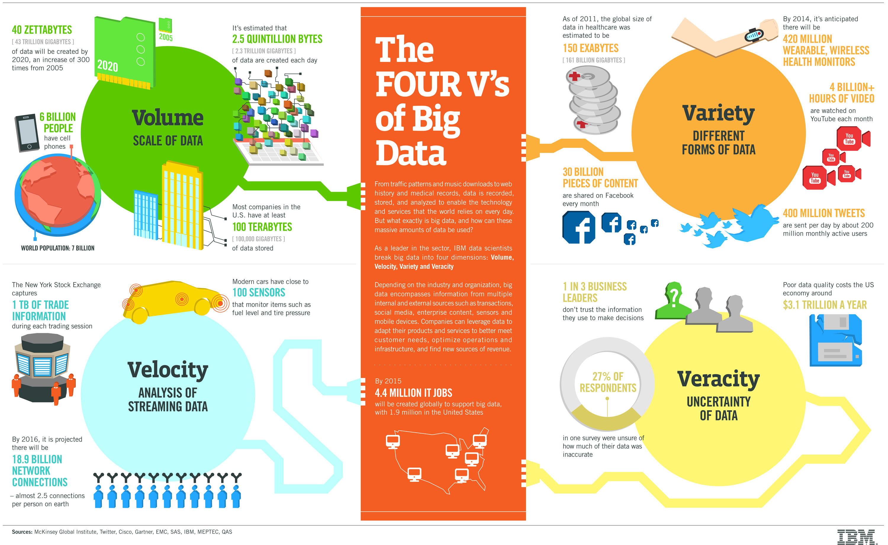

Slide 32

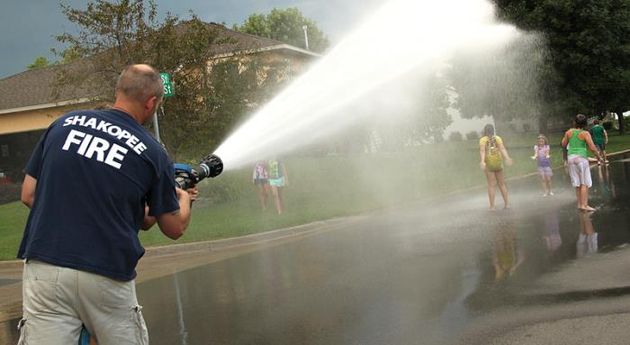
Tradition v Potential
Tradition
Potential
Notes:
Traditional data sources – versus potentials drinking from firehose…

Slide 33
Example 1
“MatrixFlow is applied to visualize heart failure (HF) symptom events
extracted from a large cohort of HF cases and controls (n=50,625),
which allows medical experts to reach insights involving temporal patterns
and clusters of interest, and compare cohorts in novel ways that may lead
to improved disease diagnoses.”
AMIA Annu Symp Proc. 2012;2012:716-25. Epub 2012 Nov 3.
Notes:
In last 5+ years – in 2012 – beginning to show potential of big data- HF – looking at temporal patterns of developing

Slide 34
Example 1

Slide 35
Example 1
Notes:
Network linking these events – vicki will discuss more on networks later this semester – connections…

Slide 36
Example 1
Notes:
Linkages between nodes – viewing this clinical network…

Slide 37
Example 1
Notes:
Ways to view clusters – hierarchical clustering

Slide 38
Example 1

Slide 39
Example 1
Notes:
Evolution of symptoms from Framingham cohort

Slide 40
Example 1

Slide 41
Example 1

Slide 42
Example 2
“…tensor factors are reported as phenotype candidates that automatically reveal
patient clusters on specific diagnoses and medications.”
31 815 patient records over 7 years in the Geisinger Health System
Heart failure onset prediction study
J Biomed Inform. 2014 Dec;52:199-211. doi: 10.1016/j.jbi.2014.07.001.
Notes:
Joyce Ho in Emory computer science

Slide 43
Example 2

Slide 44
Example 2
Notes:
Factor into dimensions – tensor is a multidimensional matrix – rows and columns and layers

Slide 45
Example 2

Slide 46
Example 3
Goal: “to develop a data-driven strategy to (1) infer phenotypic topics within
patient populations and (2) assess the degree to which such topics facilitate a
mapping across populations in disparate healthcare systems ”
Used 4 months of EHRs from
Vanderbilt University Medical Center
Northwestern Memorial Hospital
Journal of Biomedical Informatics 55 (2015) 82–93
Notes:
From Vanderbilt and northwestern – topics not just words but an almagation of words and

Slide 47
Example 3

Slide 48
Example 3
Notes:
Phenotype wide association PheWAS

Slide 49
Example 3
Notes:
V7 was Vanderbilt and N was Northwestern – high similarity

Slide 50
Example 3
Notes:
V4 similar to N2, N4 and N17…

Slide 51
Example 3
Notes:
Took the topics and related them – heatmap of interrelationships and a network layout

Slide 52
Let’s take a short break now
And now a word from Susan Etlinger…

Slide 53
What is Data Science?
Drew Conway: https://s3.amazonaws.com/aws.drewconway.com/viz/venn_diagram/data_science.html

Slide 54
Hal Varian on Statistics and Data
“I keep saying the sexy job in the next ten years will be statisticians. People think I’m joking, but who would’ve guessed that computer engineers would’ve been the sexy job of the 1990s?”
Hal Varian, Google Chief Economist, The McKinsey Quarterly, 2009

Slide 55
More from Hal Varian
The ability to take data – to be able to understand it, to process it, to extract value from it, to visualize it, to communicate it’s going to be a hugely important skill in the next decades, not only at the professional level but even at the educational level for elementary school kids, for high school kids, for college kids. Because now we really do have essentially free and ubiquitous data. So the complimentary scarce factor is the ability to understand that data and extract value from it.
I think statisticians are part of it, but it’s just a part. You also want to be able to visualize the data, communicate the data, and utilize it effectively. But I do think those skills – of being able to access, understand, and communicate the insights you get from data analysis – are going to be extremely important. Managers need to be able to access and understand the data themselves.

Slide 56
What is a Data Scientist?
“A data scientist is someone who can obtain, scrub, explore, model and interpret data, blending hacking, statistics and machine learning. Data scientists not only are adept at working with data, but appreciate data itself as a first-class product”
Hilary Mason, former CSO, bit.ly

Slide 57
Data Science Successes
Notes:
Transformative power that this has influenced on sports industry – recruiting teams – oakland A’s were only ones doing this for nearly a decade till most use it now …

Slide 58
Data Science Successes
Notes:
Ask for students to share data science success stories – for example googling itself

Slide 59
Data Science Successes
Google and Netflix recommendations
Spell check, Google Translate
Target
Dickey’s BBQ
HealthPatch
CordMatch
Notes:
Dickey’s bbq – uses real time streaming for targeted marketing – special on ribs by location to get target sales; healthpath look at risk of sepsis patch streams data back to hospital; cordmatch able to take patients with stemcells cord transplant facilitates matching

Slide 60
What Is Data Science?
Data science is about the whole process pipeline to extract information out of data.
The pipeline:
0. Identify the question
Prepare to run the model
Run the model
Communicate the results / deliver data product
Notes:
Focus in this class on the pipeline

Slide 61
Data Science is about Data Products
Data products empower others to use the data
Examples:
Global Burden of Disease
Flu Near You

Slide 62
Data Science Skills
Science – domain area knowledge
Data wrangling
Programming
Statistics
Machine Learning
Communication
Sharing
Keep in mind need for reproducibility

Slide 63
Data Science Question Types
Descriptive
Exploratory
Inferential
Predictive
Causal

Slide 64
Descriptive Data
Census
Google n-gram
Notes:
Albert Einstein, Sherlock holmes, frankenstein

Slide 65
Exploratory Data Analysis
Purpose is to discover new questions
Not final
Not generalizable

Slide 66
Inferential Analysis
Extend conclusions about a small number of observations to a larger population
Estimate a quantity and its variability
Statistical testing

Slide 67
Prediction
X predicts Y
Target
Notes:
Target figured out girl was pregnant before her father

Slide 68
Causality
Experiment
Randomized clinical trials are the gold standard

Slide 69
Caution
Make sure that your analyses are reproducible

Slide 70
Data Sharing
Required, if not by NIH, by journal
Have a plan
An outsider should be able to run the whole pipeline from the original raw data to produce the given results

Slide 71
Tools We Will Use in This Class
R
RStudio
RMarkdown
Git
GitHub

Slide 72
Why R and RStudio?
Free
Rich set of packages
Active developer community
RStudio - Integrated Development Environment (IDE)

Slide 73
Why R Markdown?
R package
Integrates nicely with RStudio
Creates dynamic documents with R

Slide 74
Why Git and GitHub?
Git – version control system
GitHub – depository

Slide 75
Data - OED
“Facts and statistics collected together for reference or analysis”
Notes:
Oxford English dictionary OED

Slide 76
Data - OED
“Facts and statistics collected together for reference or analysis”

Slide 77
Data - OED
“Facts and statistics collected together for reference or analysis”

Slide 78
Data - OED
“Facts and statistics collected together for reference or analysis”
Notes:
Quantitative or qualitative “facts”

Slide 79
What is “data”?
https://www.youtube.com/watch?v=EMHP-q4GEDc
Notes:
Somewhat elementary – but watch later…

Slide 80
Examples of Data
https://rdp.cme.msu.edu/tutorials/images/ini_pro/mock_in002.png
Notes:
Here is a FASTQ file from a gene sequencer

Slide 81
Example of Data
Electronic Medical Record
Sample Medical Record: Monica Latte. Content last reviewed May 2013. Agency for Healthcare Research and Quality, Rockville, MD. http://www.ahrq.gov/professionals/prevention-chronic-care/improve/system/pfhandbook/mod8appbmonicalatte.html
Notes:
Electronic health record – autocorrects EHR to HER… so typed EMR here…

Slide 82
Most Important Qualities of a Data Science Investigation
Question
Question
Question
Data

Slide 83
More Information
Halevy, Norvig, Pereira: The Unreasonable Effectiveness of Data (in Canvas folder)
Tim Berners Lee on open data
David McCandless: Information is Beautiful
Notes:
We’ll get this posted later… Halevy article… click return to the talk…

Slide 84
About This Class

Slide 85
Evaluation
Homework (8 total, 5% each) - 40%
Final Big Data Project (presentation and report) - 60%
Milestone 1 – 5%
Milestone 2 – 10%
Milestone 3
Oral Presentation – 20%
Slide deck – 5%
Paper – 20%

Slide 86
Due Dates
Assignments are due at 5 pm Eastern Time on the date listed on the syllabus. Files must be uploaded in pdf format to the Canvas site.
At 5:01 pm, the upload link will disappear.
Failure to upload by the due date will result in a 0 for that assignment.

Slide 87
Topics
Research reproducibility
Data wrangling
Exploratory Data Analysis
Statistical models
Prediction
Clustering and Classification
Natural language processing

Slide 88
Who Are We?
Vicki Hertzberg
vhertzb@emory.edu
7-1881
Melinda Higgins
mkhiggi@emory.edu
7-5180

Slide 89

Vicki Hertzberg
At Emory for 22 years
BS from Miami University
PhD from University of Washington
Married, two married children, one grandchild expected
Hobbies
Reading
Fiber arts (quilting, knitting, weaving)
Cooking
Trivia: Vicki has visited 47 states

Slide 90
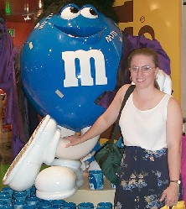
Melinda Higgins
At Emory since 20NN
Married, one child
Degrees from St. Andrews University (SC) and University of South Carolina
Hobbies
Knitting
R programming
Little known fact: Melinda attended college on an athletic scholarship

Slide 91
How to Get Help
Ask Dr. Google
Stack Overflow
Cross Validated
R Forums
Class discussions
The instructors*

Slide 92
*Email Response policy
For emails received between 8 am Monday and 5 pm Thursday, you can expect response within 24 hours
For emails received between 5 pm Thursday and 8 am Monday, you can expect response within 72 hours
When there is a Monday holiday, you can add 24 hours for the weekend email response time.
For emails received over spring break, email again on the Monday after spring break.

Slide 93
What questions do you have?

Slide 94
Let’s take a 5 minute break
And now a word from Hans Rosling

Slide 95
R – Variable Assignment
Variable_name <- value
Variable_name = value

Slide 96
R - Commands
Commands are functions
Use function(arguments)
Returns outcome to the monitor unless you assign it to a variable or a file

Slide 97
R – Data Types
Vector
Factor
Matrix
Data frame

Slide 98
Vector
Ordered set of characters or numbers
c( ) combines items to form a vector
Examples
myColors = c(“red”, “blue”, “orange”, “purple”)
myColors[1] returns the value “red”
myColors[1,4] returns the value (“red”, “purple”)
myValues = c(1,5,17,3,29,10)

Slide 99
Factor
Controlled independent variable
Looks like a vector, but elements are names from a set of possibilities with levels being a unique set of values
E.g., winter, spring, summer, fall

Slide 100
Matrix
Looks like an excel spreadsheet
Numbers only
Can be indexed by
Row and column numbers OR
Row and column names

Slide 101
Data Frame
Looks like a matrix
Can incorporate a mixture of variable types

Slide 102
Indices
In 1-dimension – vector, factor, list
In 2-dimensions, location of row, column – matrix, data frame
Indices start with 1 not 0

Slide 103
To save a session
save.image(file_name) – saves session to disk
load(file_name) – allows you to reload from disk
Remember this – save the objects
Allows you to quit and return
Don’t have to re-run slow processes

Slide 104
R Scripts
Files of R commands
Rerun your analyses
Document what you did

Slide 105
This will happen to you…

Slide 106
Handover to Melinda

